Slide 1
Cambio Group Project Details
Group size: 3 (self-chosen TODAY!)
Presentation length: 10 minutes
When: Weeks 14 and 15
Steps:
Choose your three person groups and communicate those group members to Joel and Steven (1 point)
Pitch your group project idea through an ~two paragraph project proposal via Canvas submission: what you would like to test/model with ideas for implementation and planned division of labor (4 points)
Sign up for and participate in a 20-minute group meeting with Joel and Steven to refine project ideas and process (10 points)
Group presentation: group roles, methods, results, interpretation, and connection to KNOW content (40 points, 20 pts for presentation and 20 points for quality of project work)
Project rubric and full details will be posted later this week on Canvas (including dates)

Slide 2
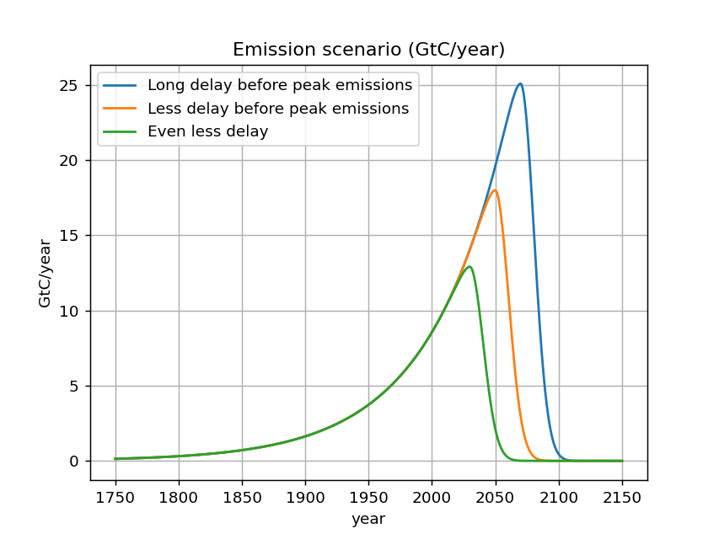
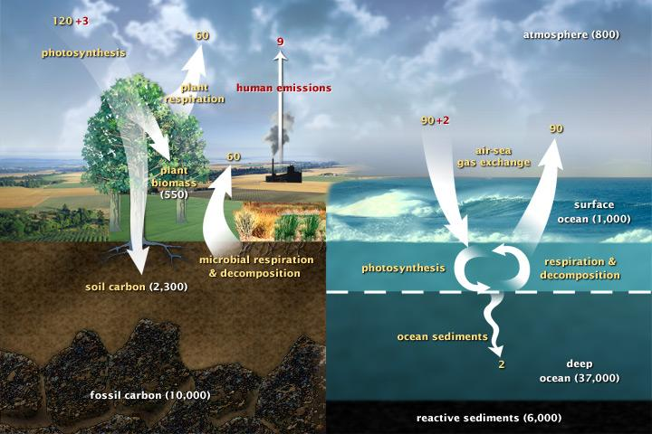

Slide 3
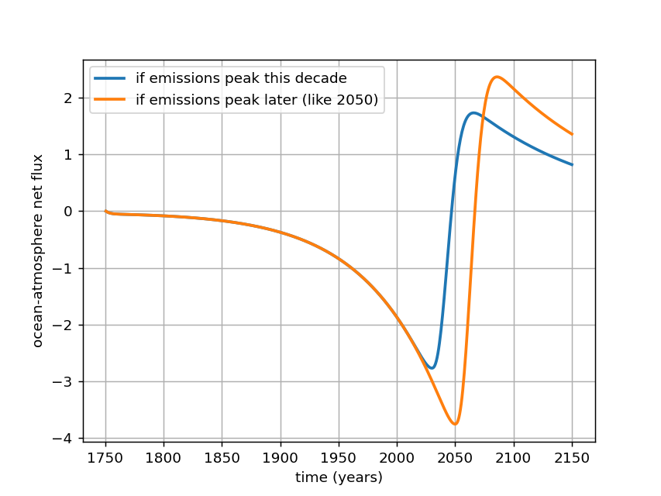
Project ideas: What is the intergenerational debt associated with a longer delay?

Slide 4
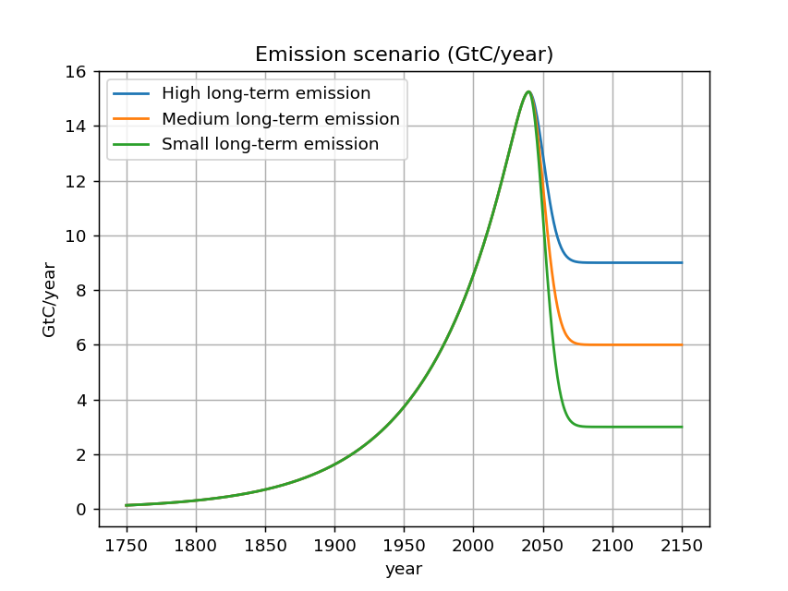

Slide 5
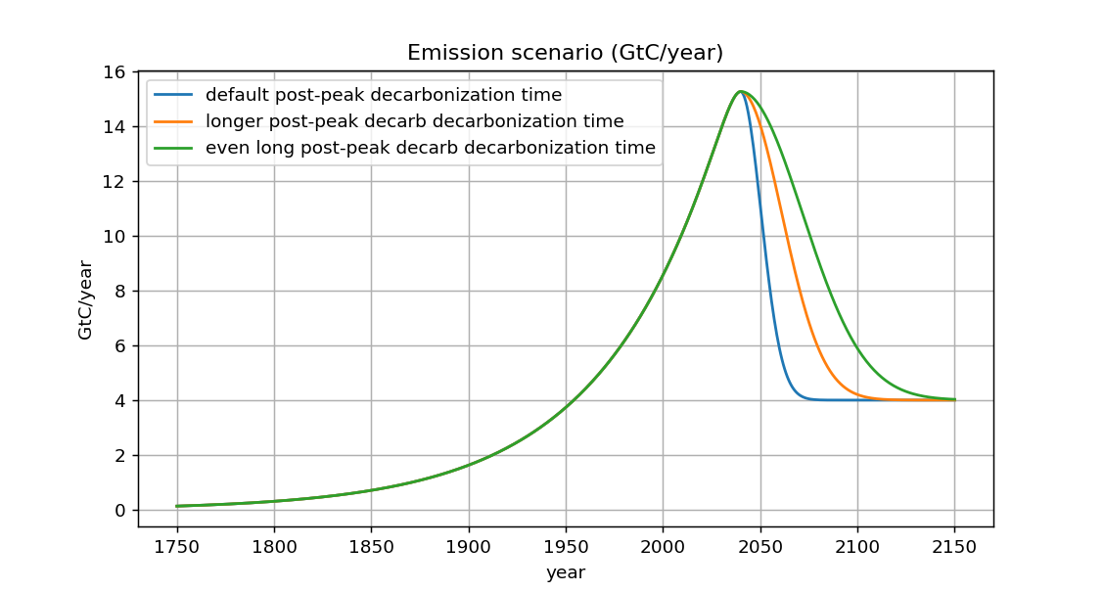

Slide 6

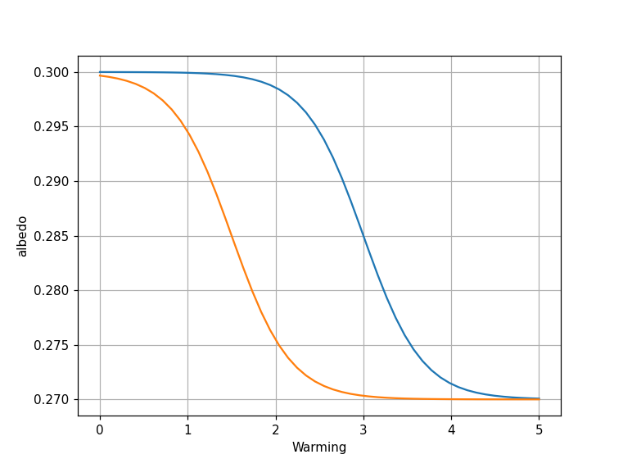
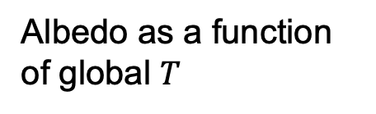
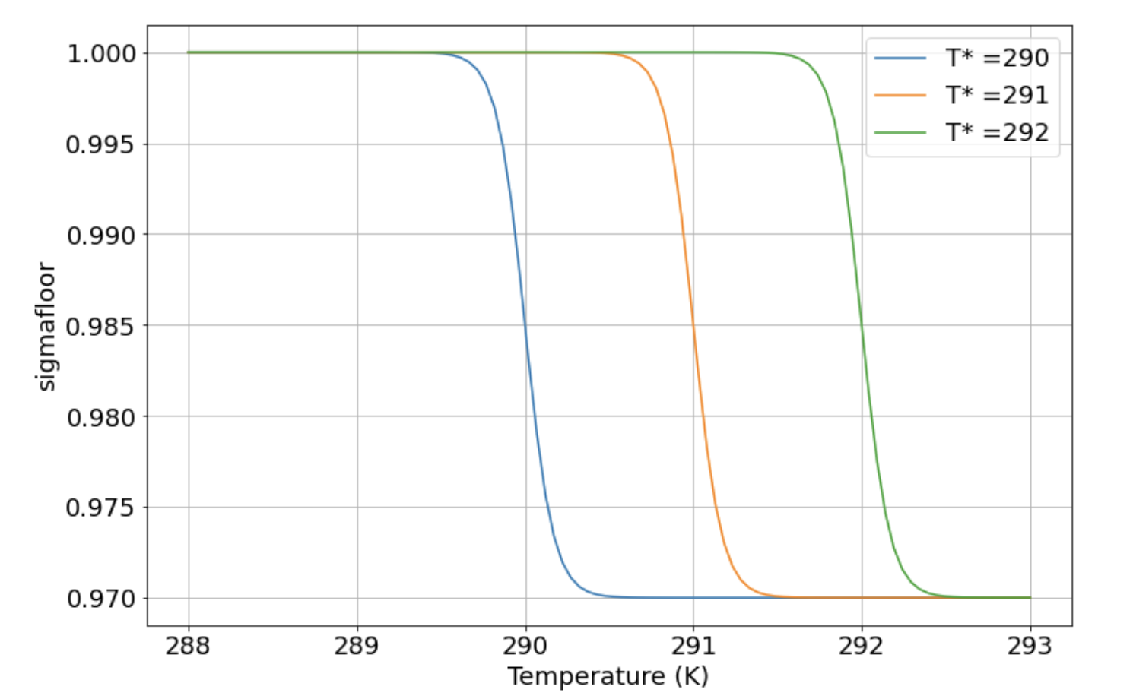
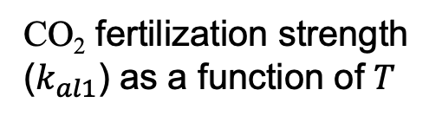

Each version of Cambio has a lot of uncertainty in its parameterization, that you could explore
van’t Hoff feedback strength (Cambio 2.0) … there’s no tipping point (it’s a linear feedback), but what if we have the feedback strength (“DC”) wrong?
Cold ocean
Warm ocean
Ice-albedo feedback (Cambio 3.0) … there are big uncertainties in the tipping point temperature, abruptness, how extreme the reduction in albedo will be.
CO₂ fertilization feedback inhibition (Cambio 4.0) … big uncertainties in the tipping point temperature, etc., the reduction in the CO₂ fertilization will be.

Slide 7

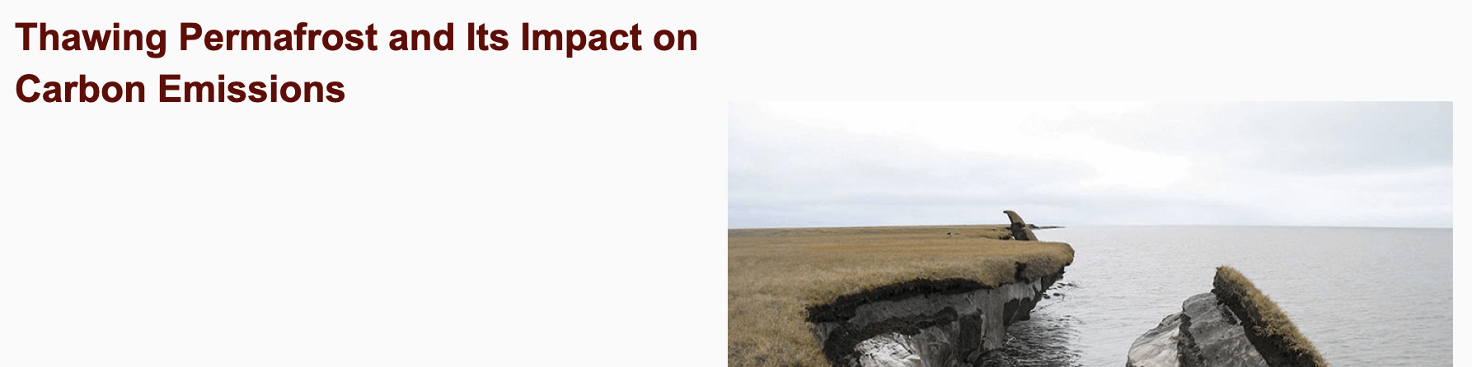
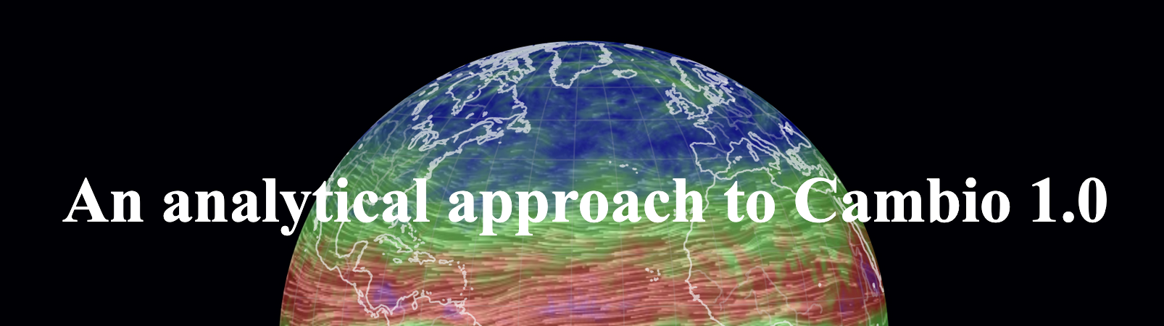

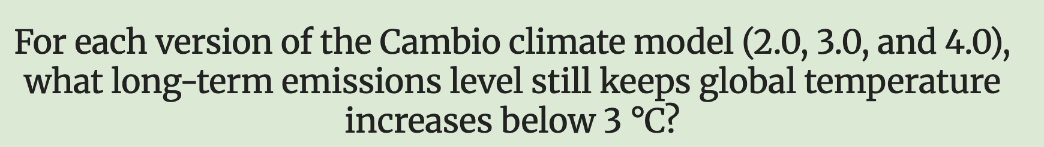


Here are some past project titles

Slide 8
Other project ideas:
Sea level rise
Ocean acidification
Carbon capture technologies
Natural sink enhancement/degradation
Ice sheet melt event
Artificial changes in albedo
Needed changes to hit historic climate sensitivity (°C/2x CO₂)
Massive tree planting effort effects

Slide 9
Cambio Group Project Group Creation
Write your top three project ideas/interests (5 minutes)
Full class share of top three project interests/ideas (5 minutes)
In-class time to create three person groups, claim your project idea, and sign up for a meeting with Joel and Steven (on Canvas) (10 minutes)
If you are having trouble finding a group, come to the front of the room to find others still looking!
(If finish early) Begin drafting your project pitch. Canvas submission will go live once project groups are established.

Slide 10
Cambio Group Project Details
Group size: 3 (self chosen)
Presentation length: 10 minutes
When: Weeks 14 and 15
Steps:
Choose your three person groups and communicate those group members to Joel and Steven via Google Spreadsheet on Canvas Homepage + sign up for a project meeting slot (1 point)
Pitch your group project idea through an ~two paragraph project proposal via Canvas submission: what you would like to test/model with ideas for implementation and planned division of labor (4 points)
Sign up for and participate in a 20-minute group meeting with Joel and Steven to refine project ideas and process (10 points)
Group presentation: group roles, methods, results, interpretation, and connection to KNOW content (40 points, 20 pts for presentation and 20 points for quality of project work)

